Slide 1

Linear Regression
Teoh Teik Toe
ITOM/NBS
ttteoh@ntu.edu.sg
97905202

Slide 2
Reading before class
Regression : https://www.dropbox.com/sh/dcz4m1ps91mimzz/AACBicbA3-KABogiJ3iWu5N9a?dl=0
Quantile : https://www.dropbox.com/sh/lickupqy8lkcol4/AAAQGMg8j8UQYWM8Tg25duEva?dl=0
Mars : https://www.dropbox.com/sh/fdqwz0elrgeww1c/AADWRzjIRqqspuKsz0sxZI24a?dl=0

Slide 3
Agenda
Intro to Linear Regression
DBS (Regression)
Equity Financial Data (Classification)
Treynor (Regression)
Sharpe Ratio
Review
Practice: Bankruptcy Data, German Credit Data

Slide 4
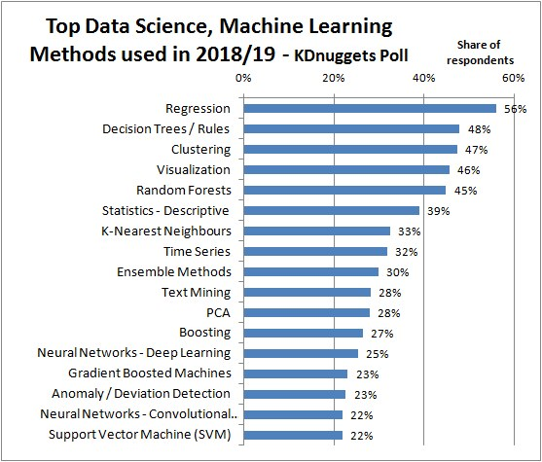
https://images.app.goo.gl/RZL5fApQc5t4syyr5

Slide 5
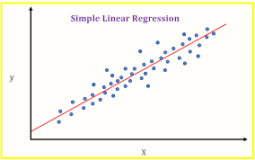
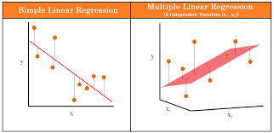
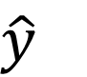
Linear Regression Model Line
Coefficient – Try and Error (Brute Force)
$y=b_{0}+{b_{1}x}_{1}+b_{2}x_{2}+…+b_{m}x_{m}+e$
$\hat{y}$
Must be normally distributed
Use QQ Plot test

Slide 6
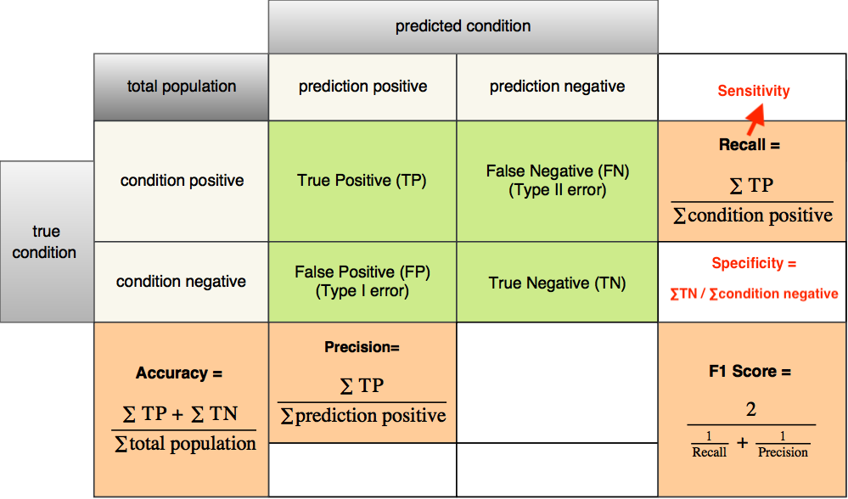
Measurement of a model on test set: Accuracy (For Classifier), for continuous, using RMSE on slide 31
https://images.app.goo.gl/yGHjQrE27emHFTRd7

Slide 7
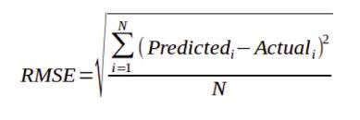
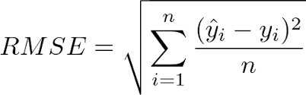
Continuous aka Regression Y
MSE
RMSE

Slide 8
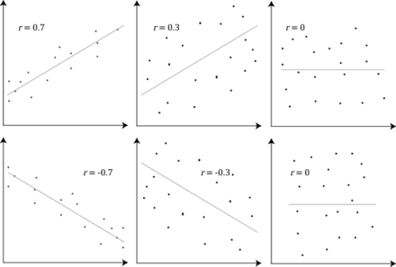
Correlation and Dependence
https://www.wikiwand.com/en/Correlation_and_dependence

Slide 9
When to Use Regression
Supervised Learning (historical labeled data available)
Trend Prediction like
Financial Prediction
Economic Prediction
Pattern Recognition (Business Insights)
Sales
Purchase
Voting Pattern

Slide 10
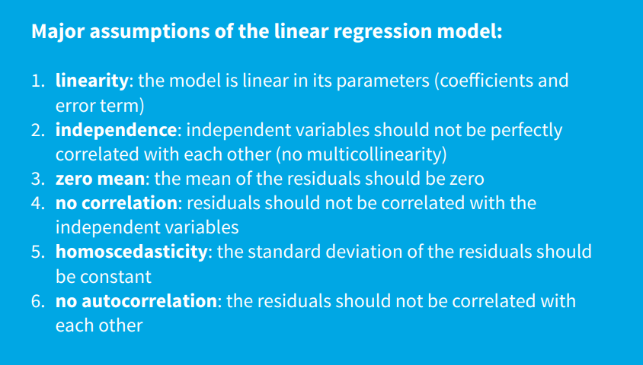
Assumption: Hilpisch Page 34

Slide 11
Regression Interview Questions (Can we answer all after this class)
What are the important assumptions of Linear regression?
What is heteroscedasticity?
What is the difference between R square and adjusted R square?
How to find RMSE and MSE?
What are the possible ways of improving the accuracy of a linear regression model?
How to interpret a Q-Q plot in a Linear regression model?
What is the significance of an F-test in a linear model?
What are the disadvantages of the linear model?
https://www.proschoolonline.com/blog/data-science-interview-questions-on-linear-regression

Slide 12

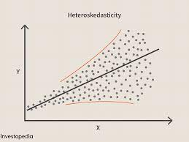
What is heteroscedasticity?
Heteroscedasticity is exactly the opposite of homoscedasticity, which means that the error terms are not equally distributed.

Slide 13
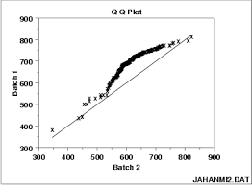
How to interpret a Q-Q plot in a Linear regression model?
A Q-Q plot is used to check the normality of errors. This shows that the errors are mostly normally distributed.

Slide 14
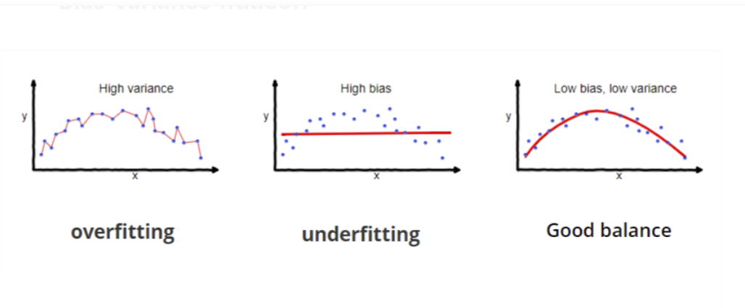
What are the disadvantages of the linear model?
Linear regression is sensitive to outliers which may affect the result.
Over-fitting
Under-fitting

Slide 15
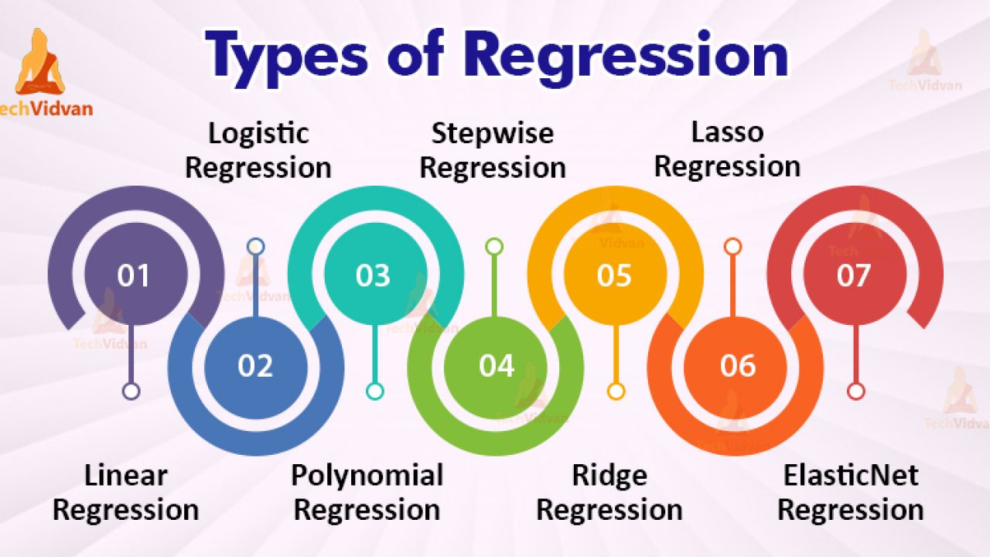
Types of Regression
https://www.youtube.com/watch?v=_3xMSbIde2I
https://www.youtube.com/watch?v=ctmNq7FgbvI

Slide 16
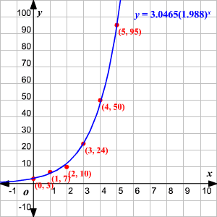

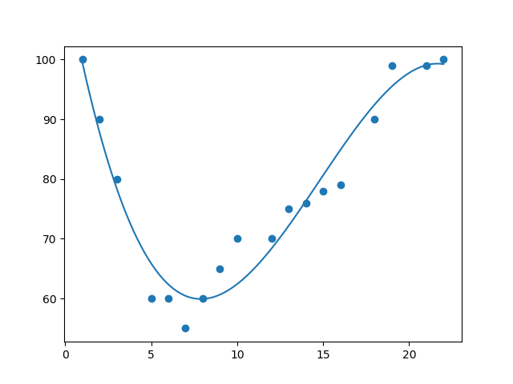
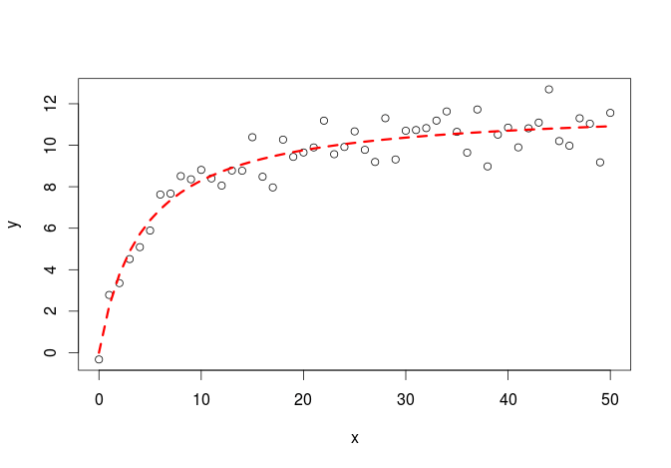
Shape of regression
Linear
Exponential
Polynomial
Logarithm

Slide 17
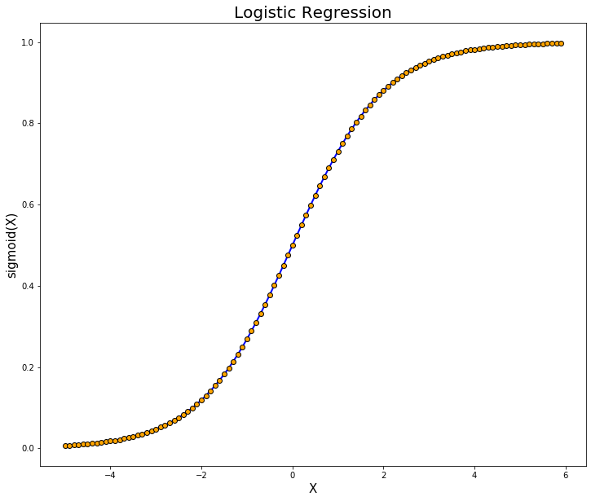
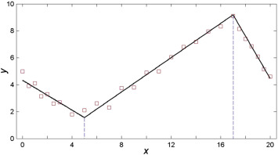
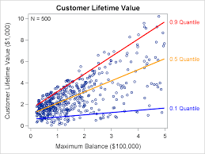
Shape of regression
Logistic
MARS (Adaptive)
Quantile

Slide 18
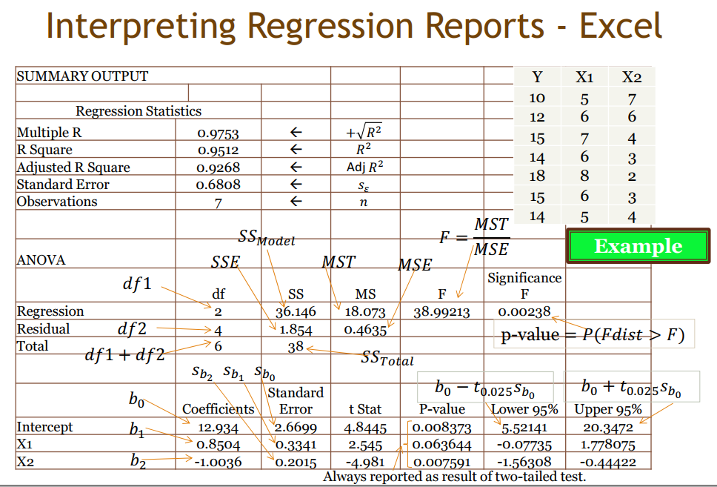
ANOVA Table
R test
F test t test

Slide 19
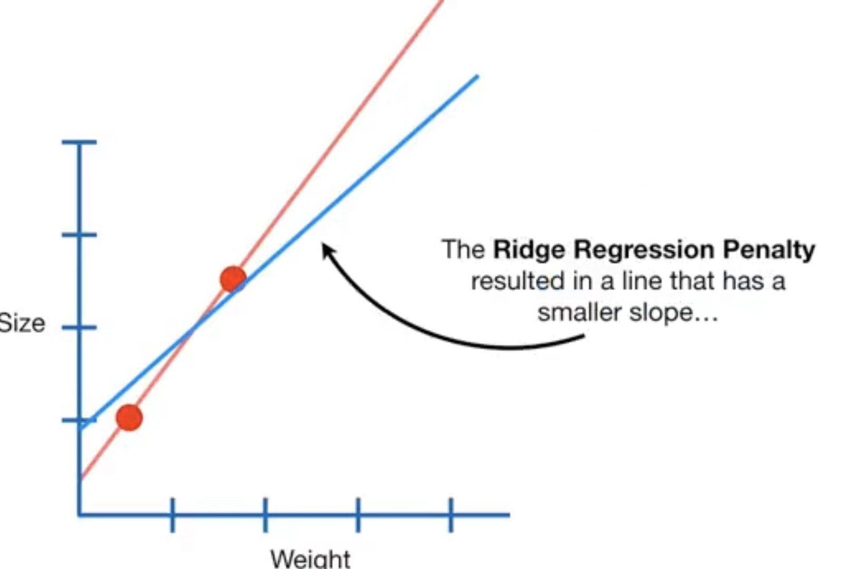
Others
Ridge (reduce the coefficients but NOT to absolute zero)
Lasso regression (make coefficients to absolute zero)

Slide 20
Programming
Check any imbalance (Use Smote if Imbalance)
Import data
Select the attribute/feature/X (correlation)
Clean the data (remove NA, not a number and outlier)
Split X,Y
Check Collinearity (VIF)
Visualize the data
Create dummy for categorical X
Normalization if needed
Split train test
Train the model
Predict
Results: Metrics (Categorical is confusion matrix, Continuous is RMSE)
QQ plot (check Heteroscedasticity)
Anova (check significant)

Slide 21
DBS Share Price Example 1. Linear 2. Non-Linear - Polynomial

Slide 22
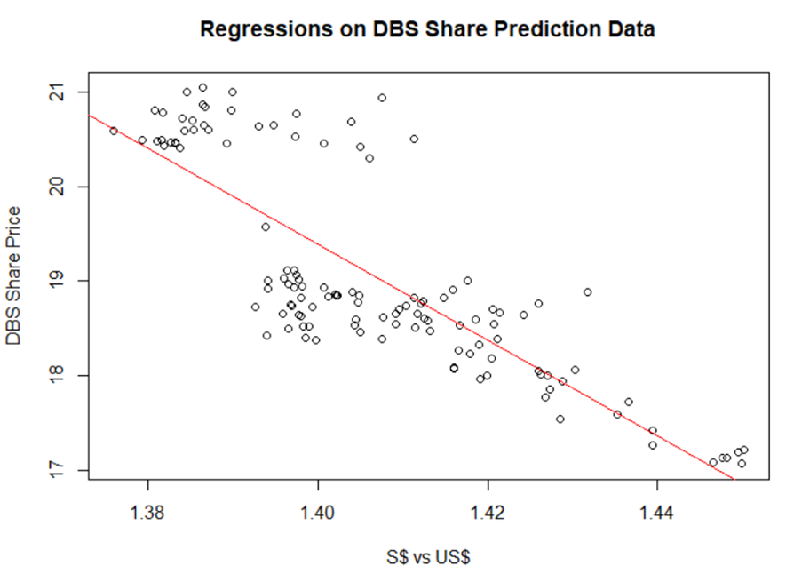
Linear Regression
Y has a linear relationship with the Xs.
Notes:
Error must be random

Slide 23
Data Analysis: When $S Strengthen, will DBS share price up or down?
When Sing Dollar strengthen, DBS share price will be expensive for foreign investor, therefore, DBS price should go down, if everything else remain the same.
However, when Sing Dollar strengthen, DBS asset in S$ will appreciate from foreign investor perspective, hence, if DBS has more Sing Dollar Asset than Liability, DBS share price should go up.
Hence, data analytics is important.

Slide 24
Regression in R
dt = read.csv("C:/Users/Teoh Teik Teo/OneDrive - TSS Global Pte. Ltd/TT Library/AI Model/Data/DBS_SingDollar.csv") #alternatively read.csv
model=lm(dt$DBS ~ dt$SGD)
summary(model)
pred = predict(model)
err = dt$DBS - pred
rmse=(mean(err^2)^0.5)
print(rmse)
dt$SGD2 = dt$SGD^2
model=lm(dt$DBS ~ dt$SGD + dt$SGD2)
summary(model)
pred = predict(model, newdata = dt)
err=dt$DBS - pred
rmse = (mean(err^2)^0.5)
print(rmse)
plot(dt$SGD, dt$DBS, main="Regression", xlab = "SGD", ylab="DBS")
abline(model)

Slide 25
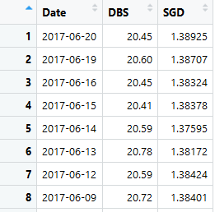
Data : Total 122 rows
R: By double click on the variable at the environment window

Slide 26
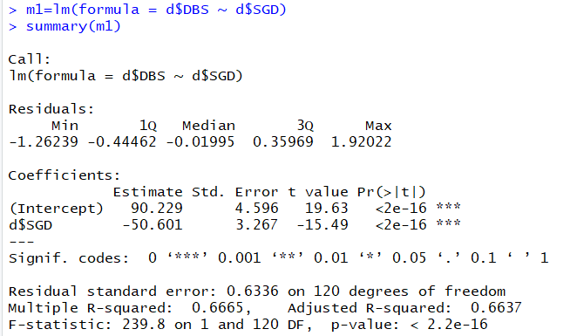

Regression: model=lm(dt$DBS ~ dt$SGD) summary(model)
P-value is very low => SGD is a significant predictor of DBS Share Price or can refer to the star
F-statistic P-value is very low => DBS = -50.601*SGD+90.229 is significant

Slide 27
Activity : What to Predict DBS Share Price base on the formula generated?
DBS = -50.601*SGD+90.229
Machine Learning Process:
After 112 set of data training: We have the coefficient of -50.601 and 90.229.
Testing:
When SGD = 1.38925, what is the error?
When SGD = 1.38707, what is the error?
When SGD = 1.38324, what is the error?
19.93122506 | -0.51877494
20.04153512 | -0.558464884
20.23533673 | -0.214663273

Slide 28
What does the formula means?
DBS = -50.601*SGD+90.229
When Singapore appreciate by 100 basis point, example 1.3800 to 1.3700, then DBS price appreciate by 50.601 * 0.01 = $0.5 (50cents).
By able to predict DBS share price accurately, there is chance that you can buy at lower price if you predict DBS price will appreciate.

Slide 29
Error
pred = predict(model, newdata=dt)
err = dt$DBS - pred
rmse=(mean(err^2)^0.5)
print(rmse)
From F-test, Polynomial is more significant than Linear
How about error? Let us take look at RMSE.
5 types of error:
Error
Square Error
Sum of Square Error
Mean Square Error
Root Mean Square Error

Slide 30
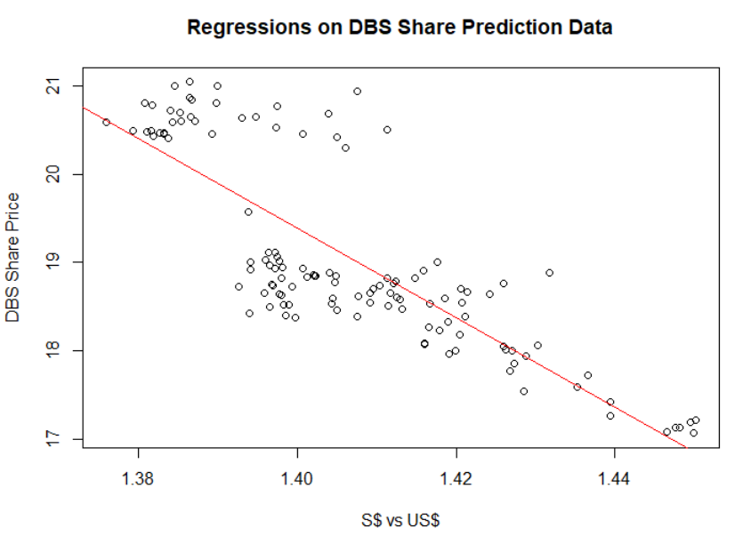
Plot Graph
plot(dt$SGD, dt$DBS, main="Regression Model", xlab = "SGD", ylab="DBS")
abline(model)
What is your conclusion on DBS Price vs Sing$?
Sing$ Strengthen, DBS price goes up
Notes:
Students are expected to look at the difference between the predicted line vs the scattered plot and find other pattern

Slide 31
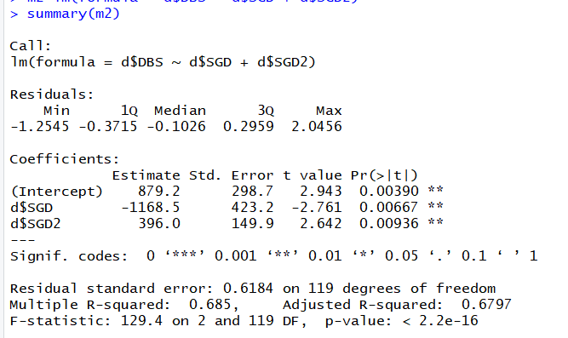
Non-Linear Model
dt$SGD2 = dt$SGD^2
model=lm(dt$DBS ~ dt$SGD + dt$SGD2)
summary(model)
Adjusted R2 for LM

Slide 32
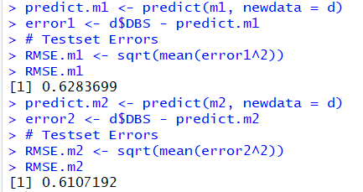
pred = predict(model, newdata = dt)
err=dt$DBS - pred
rmse = (mean(err^2)^0.5)
print(rmse)
Predict is the build in function in R, both data must be in same dimension
Notes:
M2 is better because the RMSE is lower than M1. Significant and Error are related.

Slide 33
Use Python
import pandas as pd
df = pd.read_csv("DBS_SingDollar.csv")
print(df)
X = df.loc[:,["SGD"]]
Y = df.loc[:,['DBS']]
print(X)
from sklearn import linear_model
model = linear_model.LinearRegression()
model.fit(X,Y)
pred = model.predict(X)
from sklearn.metrics import mean_squared_error
rmse = mean_squared_error(Y,pred)**0.5
print(rmse)
#print(rmse/Y.mean(axis=0)*100)
#to add polynomial
df["SGD2"] = df["SGD"] ** 2

Slide 34
Dump parameter to external file and load
from joblib import dump
dump(model, 'Regression.joblib’)
from joblib import load
model = load("Regression.joblib")
X = [[1.4]]
pred = model.predict(X)
print(pred)
import pandas as pd
df = pd.read_csv("C:/Users/Teoh Teik Teo/OneDrive - TSS Global Pte. Ltd/TT Library/AI Model/Data/DBS_SingDollar.csv")
X = df.loc[:, ["SGD"]]
pred = model.predict(X)
print(pred)

Slide 35
Other model
from sklearn import tree
model = tree.DecisionTreeRegressor()
from sklearn.neural_network import MLPClassifier
from sklearn import model = MLPRegressor(solver="lbfgs", hidden_layer_sizes=(3,4)) #hidden layer 1 is 3 neurons and hidden layer 2 is 4 neurons

Slide 36
Flask (Back End)
Check port number netstat
from flask import Flask
app = Flask(__name__)
from flask import request, render_template
import joblib
@app.route("/", methods = ["GET", "POST"])
def i():
if request.method == "POST":
name = request.form.get("name")
print(name)
num = request.form.get("rates")
print(num)
model = joblib.load("DBS Regression Model")
pred = model.predict([[num]])
print(pred)
s = "Predicted DBS Share Price : " + str(pred)
print(s)
return(render_template(“main.html", result = s))
else:
return render_template(“main.html", result ="DBS Share Price Prediction")
#change port number
if __name__ == '__main__':
app.run(host="127.0.0.1", port=int("80"))
# for mac, you may want to try port number 1111
https://stackoverflow.com/questions/60020472/kill-process-on-a-given-port-prior-to-running-a-flask-app
#if run on command line
if __name__=="__main__":
app.run(debug=True)
if __name__=="__main__":
app.run()

Slide 37
Kill port 5000 in mac
if __name__ == "__main__":
os.system('./kill.sh')
app.run(host="0.0.0.0", debug=True)
lsof -ti:5000 | xargs kill -9

Slide 38
Front End HTML
<html>
<body>
<form action = "http://localhost:5000/" method = "post">
<p>Enter Name:</p>
<p><input type = "text" name = "nm"></p>
<p>Enter Sing to US:</p>
<p><input type = "number" step="0.01" name = "num"></p>
<p><input type = "submit" value = "submit"></p>
</form>
{{sentence}}
</body>
</html>

Slide 39
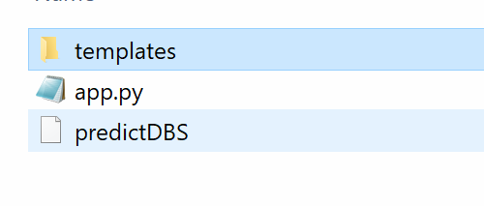
Github and Heroku Step 1 Create app.py, MLmodel and templates

Slide 40
Heroku
Edit Procfile using notepad. In Procfile: web: gunicorn main:app
<form action="http://127.0.0.1:5000" method="POST"> change to / instead of <form action="/" method="POST">
Download requirements.txt (remove the last statement – Keras CPU if you are not using Keras)
3.. Upload to github
– Create a new repository (go to repository and press new)
– Remember to use drag and drop (so that subdirectory can work)
- Remember to download to app.py and upload app.py if you are using Jupyter (DO NOT UPLOAD .ipynb)
4.Go to Heroku Dashboard (top left) – New
5. Go to setting – Add buildpack – Select Python
6. Go to deploy – Connect to GitHub and Deloy branch

Slide 41
Virtual Environment (Optional)
1. Create virtual environment using cmd
python -m venv v09021930
v09021930\Scripts\activate.bat
2. pip install gunicorn, flask, joblib, sklearn
3. pip freeze > requirements.txt
4. Edit requirements.txt (if needed, usually no)

Slide 42
Requirements.txt for heroku
click==8.0.3 colorama==0.4.4 Flask==2.0.2 itsdangerous==2.0.1 Jinja2==3.0.3 joblib==1.1.0 MarkupSafe==2.0.1 numpy==1.22.2 scikit-learn==1.0.2 scipy==1.8.0 sklearn==0.0 threadpoolctl==3.1.0 Werkzeug==2.0.2 gunicorn==20.1.0

Slide 43
Example of requirements.txt
absl-py==1.0.0
astunparse==1.6.3
cachetools==5.0.0
certifi==2021.10.8
charset-normalizer==2.0.11
click==8.0.3
colorama==0.4.4
Flask==2.0.2
flatbuffers==2.0
gast==0.5.3
google-auth==2.6.0
google-auth-oauthlib==0.4.6
google-pasta==0.2.0
grpcio==1.43.0
gunicorn==20.1.0
h5py==3.6.0
idna==3.3
importlib-metadata==4.10.1
itsdangerous==2.0.1
Jinja2==3.0.3
joblib==1.1.0
keras==2.8.0
Keras-Preprocessing==1.1.2
libclang==13.0.0
Markdown==3.3.6
MarkupSafe==2.0.1
numpy==1.22.2
oauthlib==3.2.0
opt-einsum==3.3.0
protobuf==3.19.4
pyasn1==0.4.8
pyasn1-modules==0.2.8
requests==2.27.1
requests-oauthlib==1.3.1
rsa==4.8
scikit-learn==1.0.2
scipy==1.8.0
six==1.16.0
sklearn==0.0
tensorboard==2.8.0
tensorboard-data-server==0.6.1
tensorboard-plugin-wit==1.8.1
tensorflow-io-gcs-filesystem==0.24.0
termcolor==1.1.0
tf-estimator-nightly==2.8.0.dev2021122109
threadpoolctl==3.1.0
typing_extensions==4.0.1
urllib3==1.26.8
Werkzeug==2.0.3
wrapt==1.13.3
zipp==3.7.0

Slide 44
Ridge and Lasso
model= linear_model.Ridge()
model.fit(X, Y)
pred=model.predict(X)
print(mean_squared_error(pred, Y)**0.5)
model= linear_model.Lasso()
model.fit(X, Y)
pred=model.predict(X)
print(mean_squared_error(pred, Y))

Slide 45
Activity
Use Excel

Slide 46
Machine Learning Process
Import data
Decide on Target/Y/Dependent Variable
Check null
Select features – if clean, use Kbest, else use correlation
Dropna()
Categorical input – Use Dummy variable – if too categories, drop the variable
Remove Outlier (use boxplot to check if any outlier)
Normalization (use df.describe to check if normalization is needed)
Check number of category of Y (Only for categorical data)
Check imbalance on Y using value count – if needed apply oversampling SMOTE on the train set only (only for categorical)
Split data in X,Y
Split into train test
Import model
Train on trainset
Test on testset (rmse if continuous Y and accuracy if categorical Y. If categorical, need to use confusion matrix to ensure no bias in prediction on one category)

Slide 47
Financial Data for Equity

Slide 48
Import data & Feature Selection
#replace word with number if needed
df['default'] = df["default"].replace(("Yes", "No"), (0,1))
import pandas as pd
df = pd.read_csv("Equity.csv")
df.isnull().any()
#pd.set_option("display.max_columns", None)
#pd.set_option("display.max_rows", None)
#feature selection
c = df.corr()
c = abs(c["Class"])
#Selecting highly correlated features
f = c[c>0.1]
f.sort_values()
df.isnull().sum().sort_values()
df = df.loc[:, ["Class", "Dividend per Share", "10Y Net Income Growth (per Share)", "10Y Shareholders Equity Growth (per Share)", "EBIT", "Net Income", "Sector"]]
d = df.isnull().any()
d[d==True]
d["EBIT"]
from sklearn.feature_selection import SelectKBest, f_regression
f = SelectKBest(score_func=f_regression, k=5)
f = f.fit(X, Y)
f = f.get_support()
f = X.columns[f]
f

Slide 49
Data Cleaning and Data Visualization
#Data Cleaning
df = df.dropna()
df.hist()
import seaborn as sns
sns.heatmap(df.corr())
#remove not a number
for i in df.columns:
df1 = pd.to_numeric(df[i], errors='coerce’)
df=df[df1.notnull()] #make it to null then remove null
print(df)

Slide 50
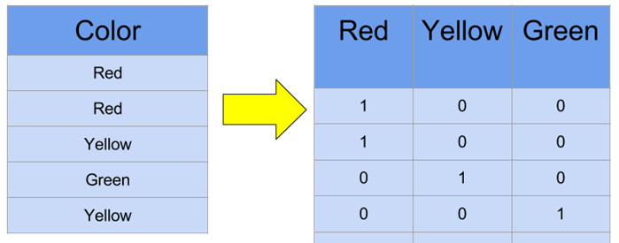
Dummy variables
df["Sector"].value_counts()
#X is categorical
dummy=pd.get_dummies(df["sector"])
df=df.merge(dummy, left_index=True, right_index=True)
df=df.drop(columns = "sector")

Slide 51
Remove Outlier
#remove outlier
import numpy as np
from scipy import stats
z = stats.zscore(df.astype(np.float)) #zscore conversion need float
z = np.abs(z) #convert all to positive because the parity is not important
f = (z < 4).all(axis=1) #3 is your choice, axis =1 means by columns, f is a flag
df = df[f]

Slide 52
Split
#split X,Y
Y = df.iloc[:, 0]
X = df.iloc[:, 1:4]
#X = df.drop(columns="Class")

Slide 53
Normalization
#normalization
from scipy import stats
import numpy as np
X["Net Income"]=stats.zscore(X["Net Income"].astype(np.float))
X["EBIT"]=stats.zscore(X["EBIT"].astype(np.float))
#normalization
from scipy import stats
import numpy as np
pd.set_option('display.max_rows', 10)
for i in X.columns:
X[i]=stats.zscore(X[i].astype(np.float))
print(X)

Slide 54
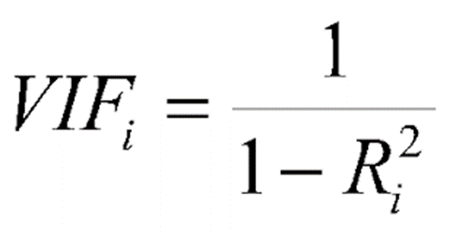
Check Collinearity
#vif to check collinearity
#1 = not correlated.
#Between 1 and 5 = moderately correlated.
#Greater than 5 = highly correlated.
from statsmodels.stats.outliers_influence import variance_inflation_factor
vif_data = pd.DataFrame()
vif_data["feature"] = X.columns
vif_data["VIF"] = [variance_inflation_factor(X.values, i) for i in range(len(X.columns))]
print(vif_data)

Slide 55
Balance the data
df["Class"].value_counts() #check imbalance
X = df.drop(columns="Class")
Y = df.loc[:, ["Class"]]
from sklearn.model_selection import train_test_split
X_train, X_test, Y_train, Y_test = train_test_split(X,Y)
from imblearn.over_sampling import SMOTE
Y_train.value_counts()
model = SMOTE()
X_train, Y_train =model.fit_resample(X_train, Y_train)
Y_train.value_counts()

Slide 56
Split train test, train, predict
from sklearn import linear_model
model = linear_model.LogisticRegression()
model.fit(X_train, Y_train)
pred = model.predict(X_train)
from sklearn.metrics import confusion_matrix
cm = confusion_matrix(Y_train, pred)
print(cm)
accuracy = (cm[0,0]+cm[1,1])/sum(sum(cm))
print(accuracy)
pred = model.predict(X_test)
cm = confusion_matrix(Y_test, pred)
print(cm)
accuracy = (cm[0,0]+cm[1,1])/sum(sum(cm))
print(accuracy)

Slide 57
Export the coefficient for testing/prediction Save and Load
# save the model to disk
import joblib
joblib.dump(model, "regression")
# load the model from disk
model1 = joblib.load('regression'))
pred = model1.predict(X_test)
cm = confusion_matrix(Y_test, pred)
print(cm)
accuracy = (cm[0,0]+cm[1,1])/sum(sum(cm))
print(accuracy)

Slide 58
Predict Only (totally new data)
import pickle
model = pickle.load(open('/content/RegressionEquityModel', 'rb’))
X_predict = [[0, 0.2, 0.2]]
pred = model.predict(X_predict)
print(pred)
#from file
import pandas as pd
df = pd.read_csv("Equity (Predict).csv")
X_predict = df.loc[:, ["Dividend per Share", "10Y Net Income Growth (per Share)", "10Y Shareholders Equity Growth (per Share)"]]
X_predict = X_predict.dropna()
# load the model from disk
pred = model1.predict(X_predict)
print(pred)

Slide 59
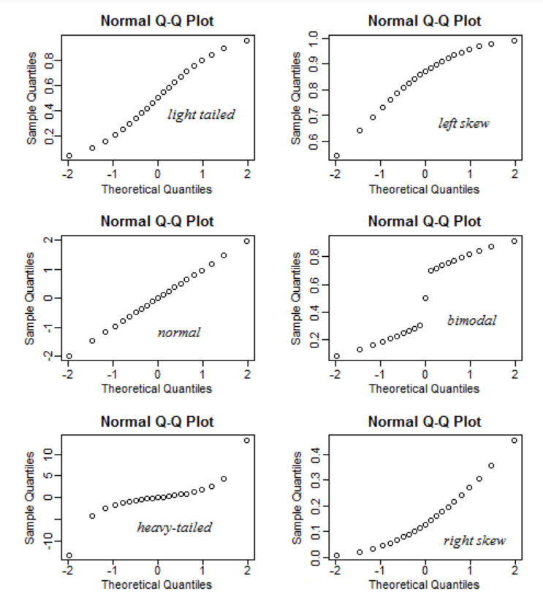
QQ plot - check heteroskedasticity – residual must be normally distributed
import statsmodels.api as sm
from matplotlib import pyplot as plt
mod_fit = sm.OLS(Y,X).fit()
res = mod_fit.resid # residuals
fig = sm.qqplot(res)
plt.show()

Slide 60
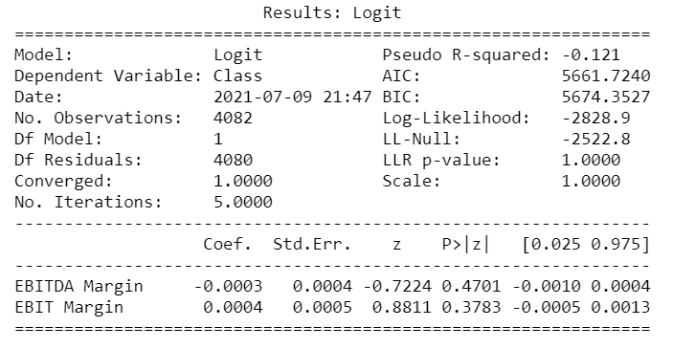
Anova
from statsmodels.formula.api import ols
from statsmodels.stats.anova import anova_lm
model = ols("Y ~ X", df).fit()
print(model.summary())
anova_results = anova_lm(model)
print('\nANOVA results')
print(anova_results)

Slide 61
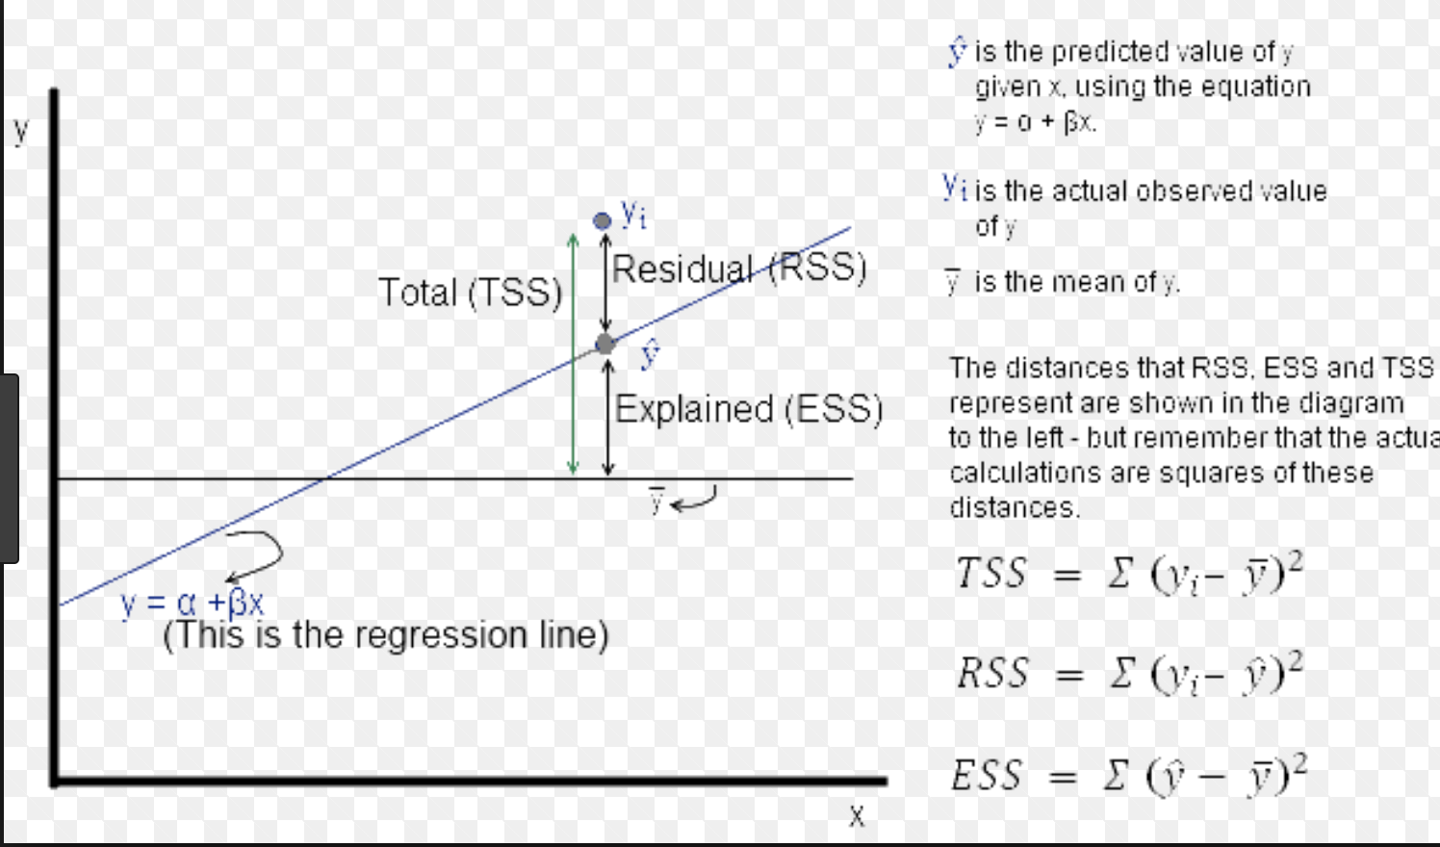
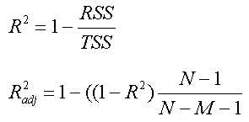
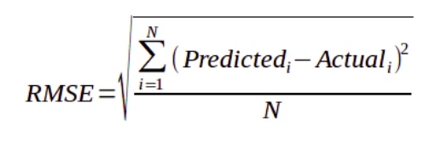
AIC Rsq RMSE
AIC = 2k + n ln(RSS)
RMSE no K
AIC reduce the weight of error but increase the weight of # of independent variable
Rsq using TSS, like ratio style, therefore max is 1
RSS

Slide 62
If you need to set threshold, use predict_prob
from sklearn import linear_model
from sklearn.metrics import confusion_matrix
import numpy as np
model=linear_model.LogisticRegression()
model.fit(X_train, Y_train)
THRESHOLD = 0.45
pred = model.predict_proba(X_train)
# [:,1] taking all rows (:) but keeping the second column (1) proba return 2 columns
pred = np.where(pred[:,1] > THRESHOLD, 1, 0)
cm = confusion_matrix(pred, Y_train)
print(cm)
accuracy = (cm[0,0] + cm[1,1])/sum(sum(cm))
print(accuracy)
pred=model.predict(X_test)
pred = model.predict_proba(X_test)
# [:,1] taking all rows (:) but keeping the second column (1) proba return 2 columns
pred = np.where(pred[:,1] > THRESHOLD, 1, 0)
cm = confusion_matrix(pred, Y_test)
print(cm)
accuracy = (cm[0,0] + cm[1,1])/sum(sum(cm))
print(accuracy)

Slide 63
Other Models
from sklearn import ensemble
model = ensemble.RandomForestClassifier()
model.fit(X_train,Y_train)
pred = model.predict(X_test)
cm = confusion_matrix(Y_test, pred)
print("accuracy : ", (cm[0,0]+cm[1,1])/(sum(sum(cm))))
model = ensemble.GradientBoostingClassifier(max_depth=10)
model.fit(X_train,Y_train)
pred = model.predict(X_test)
cm = confusion_matrix(Y_test, pred)
print("accuracy : ", (cm[0,0]+cm[1,1])/(sum(sum(cm))))

Slide 64
from sklearn import tree
model = tree.DecisionTreeClassifier(max_depth=10)
model.fit(X_train,Y_train)
pred = model.predict(X_test)
cm = confusion_matrix(Y_test, pred)
print("accuracy : ", (cm[0,0]+cm[1,1])/(sum(sum(cm))))
from sklearn import neural_network
model = neural_network.MLPClassifier(max_iter=500)
model = tree.DecisionTreeClassifier(max_depth=10)
model.fit(X_train,Y_train)
pred = model.predict(X_test)
cm = confusion_matrix(Y_test, pred)
print("accuracy : ", (cm[0,0]+cm[1,1])/(sum(sum(cm))))

Slide 65
For tree optimization
X_train1,X_test1,Y_train1,Y_test1 = train_test_split(X_train,Y_train)
for i in range(20):
model = ensemble.GradientBoostingClassifier(max_depth=i+2)
model.fit(X_train1, Y_train1)
pred = model.predict(X_test1)
cm = confusion_matrix(Y_test1, pred)
print(i+2)
print("accuracy", (cm[0,0]+cm[1,1])/(sum(sum(cm))))
print("=============")

Slide 66
Optional

Slide 67
Treynor Ratio Example with Data Wrangling Using Python

Slide 68
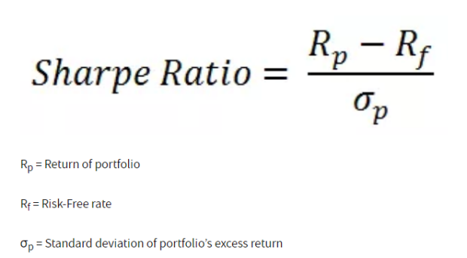
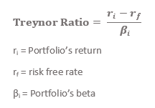
Treynor

Slide 69
Select columns
import pandas as pd
df = pd.read_csv("Treynor.csv")
df.isnull().any()
#pd.set_option('display.max_columns', 100)
#pd.set_option('display.max_rows', 20)
c = df.corr()
c = abs(c["category_treynor_ratio_10years"])
#Selecting highly correlated features
f = c[c>0.1]
f.sort_values()
#print(df.isnull().sum().sort_values())
df = df.loc[:,["fund_return_5years", "price_earnings_ratio", 'sector_communication_services', "price_book_ratio", "category_treynor_ratio_10years"]]
df["fund_return_5years"].isnull().sum()

Slide 70
Remove null and not a number
#remove na
df=df.dropna()
#remove not a number
for i in df.columns:
df1 = pd.to_numeric(df[i], errors='coerce’)
df=df[df1.notnull()] #make it to null then remove null
print(df)

Slide 71
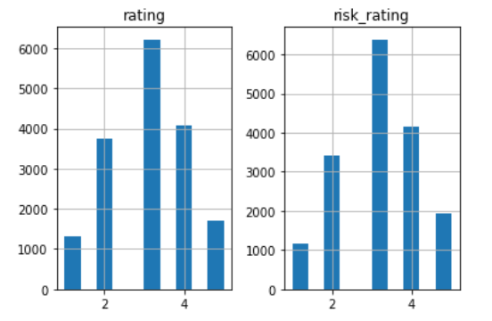
Histogram
df.hist()
import matplotlib.pyplot as plt

Slide 72
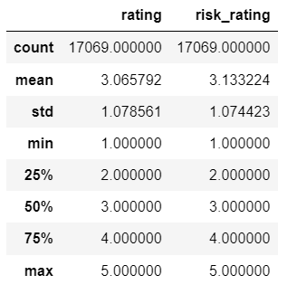
describe
df.describe()

Slide 73
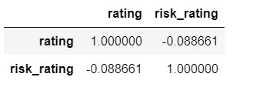
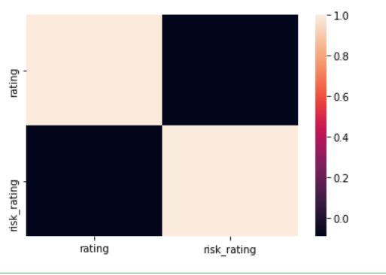
Correlation – check co-linearity, the relationship between the independent variable
df.corr()
import seaborn as sns
sns.heatmap(df.corr())

Slide 74
Split X and Y
X = df.iloc[:, 0:4]
Y = df.iloc[:, 4]

Slide 75
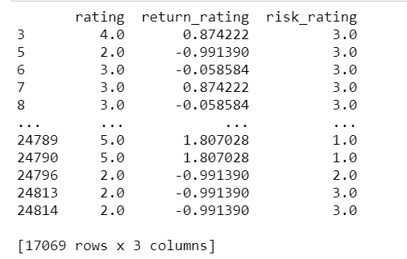
Normalization
#normalization
from scipy import stats
import numpy as np
pd.set_option('display.max_rows', 10)
for i in X.columns:
X[i]=stats.zscore(X[i].astype(np.float))
print(X)

Slide 76
Train Test Split
#split train test
from sklearn.model_selection import train_test_split
X_train, X_test, Y_train, Y_test = train_test_split(X, Y)
print(X_train, X_test, Y_train, Y_test)

Slide 77
Linear Regression
from sklearn import linear_model
from sklearn.metrics import mean_squared_error
model=linear_model.LinearRegression()
model.fit(X_train, Y_train)
pred=model.predict(X_train)
rmse=mean_squared_error(pred, Y_train)**0.5
print(rmse)
#median = df["fund_treynor_ratio_10years"].median()
pred=model.predict(X_test)
rmse=mean_squared_error(pred, Y_test)**0.5
print(rmse)

Slide 78
Lasso and Ridge
model= linear_model.Ridge()
model.fit(X_train, Y_train)
pred=model.predict(X_test)
print(mean_squared_error(pred, Y_test)**0.5)
model= linear_model.Lasso()
model.fit(X_train, Y_train)
pred=model.predict(X_test)
print(mean_squared_error(pred, Y_test)**0.5)

Slide 79
Test against Decision Tree
from sklearn import tree
model = tree.DecisionTreeRegressor()
model.fit(X_train, Y_train)
pred = model.predict(X_train)
rmse=mean_squared_error(pred, Y_train)**0.5
print(rmse)
pred=model.predict(X_test)
rmse=mean_squared_error(pred, Y_test)**0.5
print(rmse)

Slide 80
Random Forest
from sklearn import ensemble
model = ensemble.RandomForestRegressor()
model.fit(X_train, Y_train)
pred = model.predict(X_train)
pred=model.predict(X_test)
rmse=mean_squared_error(pred, Y_test)**0.5
print(rmse)
Neural Net
from sklearn import neural_network
model = neural_network.MLPRegressor(max_iter=500)
model.fit(X_train, Y_train)
pred = model.predict(X_train)
pred=model.predict(X_test)
rmse=mean_squared_error(pred, Y_test)**0.5
print(rmse)

Slide 81
Optional: Select Features
import pandas as pd
import numpy as np
data = pd.read_csv("Treynor.csv")
data.columns
data = data.dropna()
X = data.iloc[:,16:30]
Y = data.iloc[:,-1]
from sklearn.feature_selection import SelectKBest, f_regression
features = SelectKBest(score_func=f_regression, k=5)
fit = features.fit(X, Y)
print(data.columns, fit.scores_)
mask = fit.get_support()
print(mask)
new_features = X.columns[mask]
print(new_features[:])

Slide 82
Sharpe Ratio

Slide 83
Predict Tesla Beta Using Sharpe Ratio
import pandas as pd
df = pd.read_csv("Sharpe.csv")
df.isnull().any()
df=df.dropna()
df.describe()
#Normalization
from scipy import stats
import numpy as np
df.columns
df[" Market Cap (millions) "] = stats.zscore(df[" Market Cap (millions) "].astype(np.float))
X=df.iloc[:,3:6]
Y=df.iloc[:,6]
print(X,Y)
from sklearn.model_selection import train_test_split
X_train,X_test,Y_train,Y_test = train_test_split(X,Y, test_size=0.3)
from sklearn import linear_model
model = linear_model.LinearRegression()
model.fit(X_train, Y_train)
pred = model.predict(X_train)
from sklearn.metrics import mean_squared_error
rmse = mean_squared_error(pred, Y_train)**0.5
print(rmse)
pred = model.predict(X_test)
rmse = mean_squared_error(pred, Y_test)**0.5
print(rmse)

Slide 84
Other models
from sklearn import ensemble
model = ensemble.RandomForestRegressor()
model.fit(X_train, Y_train)
pred = model.predict(X_test)
rmse = mean_squared_error(pred, Y_test)**0.5
print(rmse)

Slide 85
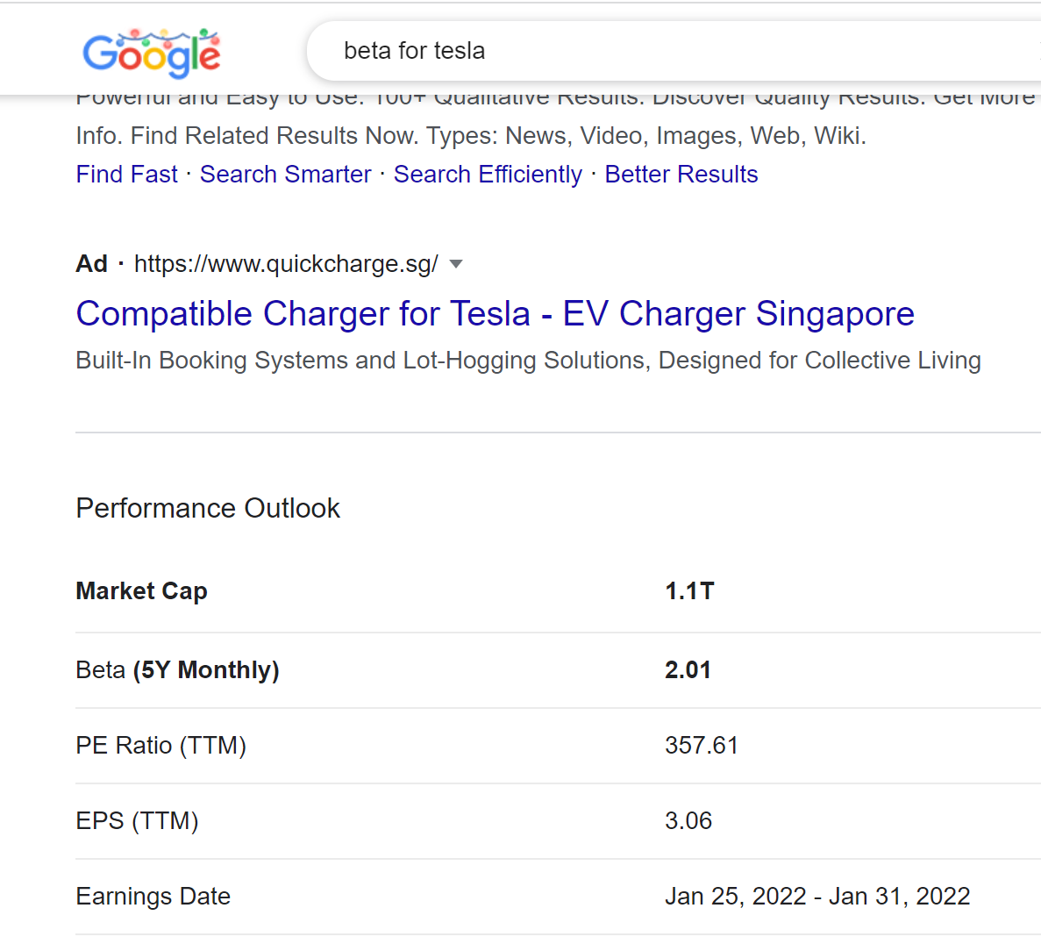
Predict Tesla Beta
# save the model to disk
import joblib
joblib.dump(model, "regression Sharpe")
# load the model from disk
model1 = joblib.load("regression Sharpe")
X_test = [[0, 840000, 111]]
pred = model1.predict(X_test)
print(pred)

Slide 86
Other Considerations
Multicollinearity – Relationship Between Variable
Time Series – Correlation between the rows
Notes:
Teach later in the class

Slide 87
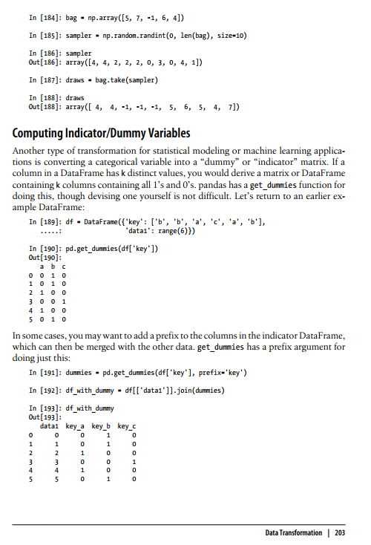
Categorical Input
Get_dummy (McKinney pg 203)

Slide 88
What have you learnt?
Regression as Prediction
Types of Regression
Other consideration

Slide 89
Reading Material (Optional)
Shwartz Pg 124 to 130 https://www.dropbox.com/s/ed9s6zyrtjgc7dk/Shwartz.pdf?dl=0
Video
https://www.youtube.com/watch?v=WWqE7YHR4Jc&t=440s
https://www.youtube.com/watch?v=aq8VU5KLmkY
Homework (optional) 25 Questions
https://blog.uwgb.edu/bansalg/statistics-data-analytics/linear-regression/

Slide 90
Optional: German Credit

Slide 91
c = df.corr()
c = abs(c["Creditability"])
#Selecting highly correlated features
#relevant_features = cor_target[cor_target>0.1]
print(c.sort_value())
import pandas as pd
df = pd.read_csv("german_credit.csv")
df.isnull().any()
df["Creditability"].nunique()
Y = df.loc[:, ["Creditability"]]
X = df.drop(columns = " Creditability ")
from sklearn.feature_selection import SelectKBest, f_regression
f = SelectKBest(score_func=f_regression, k=5)
f = f.fit(X, Y)
f = f.get_support()
f = X.columns[f]
f
#print(df.isnull().sum().sort_values())
df = df.loc[:, ["Creditability",'Account Balance', 'Duration of Credit Mths',
'Payment Status of Previous Credit', 'Credit Amount',
'Value of Savings and Stocks', 'Length of current employment',
'Sex and Marital Status', 'Most valuable available asset', 'Age',
'Concurrent Credits']]

Slide 92
Remove Outlier
#remove outlier
df.boxplot()
import numpy as np
from scipy import stats
z = stats.zscore(df.astype(np.float)) #zscore conversion need float
z = np.abs(z) #convert all to positive because the parity is not important
f = (z < 4).all(axis=1) #3 is your choice, axis =1 means by columns, f is a flag
df = df[f]

Slide 93
Normalization of Data
#normalization
from scipy import stats
import numpy as np
df["Credit Amount"] = stats.zscore(df["Credit Amount"].astype(np.float))

Slide 94
Dummy Variables for Categorical input
df["Sex and Marital Status"].value_counts()
dummy = pd.get_dummies(df["Sex and Marital Status"])
df = df.merge(dummy, left_index=True, right_index=True)
df.drop(columns="Sex and Marital Status")

Slide 95
Check Imbalance
Y.value_counts()

Slide 96
X = df.drop(columns="Creditability")
Y = df.loc[:, ["Creditability"]]
from sklearn.model_selection import train_test_split
X_train, X_test, Y_train, Y_test = train_test_split(X,Y)
from sklearn.tree import DecisionTreeClassifier
model = DecisionTreeClassifier()
model.fit(X_train, Y_train)
pred = model.predict(X_train)
from sklearn.metrics import confusion_matrix
cm = confusion_matrix(Y_train, pred)
print(cm)
accuracy = (cm[0,0] + cm[1,1])/sum(sum(cm))
print(accuracy)
pred = model.predict(X_test)
cm = confusion_matrix(Y_test, pred)
print(cm)
accuracy = (cm[0,0] + cm[1,1])/sum(sum(cm))
print(accuracy)

Slide 97
Optimization
X_train1, X_validate, Y_train1, Y_validate = train_test_split(X_train,Y_train)
for i in range(100):
print(i)
model = DecisionTreeClassifier(min_samples_split = i+2)
model.fit(X_train1, Y_train1)
pred = model.predict(X_validate)
cm = confusion_matrix(Y_validate, pred)
accuracy = (cm[0,0] + cm[1,1])/sum(sum(cm))
print(accuracy)
for i in range(10):
print(i)
model = DecisionTreeClassifier(max_depth = i+1)
model.fit(X_train1, Y_train1)
pred = model.predict(X_validate)
cm = confusion_matrix(Y_validate, pred)
accuracy = (cm[0,0] + cm[1,1])/sum(sum(cm))
print(accuracy)

Slide 98
Use Grid (max depth)
import math
from sklearn.model_selection import GridSearchCV
model = tree.DecisionTreeClassifier()
grid = GridSearchCV(estimator = model, param_grid = dict(max_depth = [i for i in range(1, 20)]))
grid_results = grid.fit(X_train, Y_train)
grid_results.best_params_

Slide 99
Random Forest
from sklearn.ensemble import RandomForestClassifier
model = RandomForestClassifier(max_depth=3)
model.fit(X_train, Y_train)
pred = model.predict(X_train)
from sklearn.metrics import confusion_matrix
cm = confusion_matrix(Y_train, pred)
print(cm)
accuracy = (cm[0,0] + cm[1,1])/sum(sum(cm))
print(accuracy)
pred = model.predict(X_test)
cm = confusion_matrix(Y_test, pred)
print(cm)
accuracy = (cm[0,0] + cm[1,1])/sum(sum(cm))
print(accuracy)

Slide 100
XGBoost
from sklearn.ensemble import GradientBoostingClassifier
model = GradientBoostingClassifier(max_depth=3)
model.fit(X_train, Y_train)
pred = model.predict(X_train)
from sklearn.metrics import confusion_matrix
cm = confusion_matrix(Y_train, pred)
print(cm)
accuracy = (cm[0,0] + cm[1,1])/sum(sum(cm))
print(accuracy)
pred = model.predict(X_test)
cm = confusion_matrix(Y_test, pred)
print(cm)
accuracy = (cm[0,0] + cm[1,1])/sum(sum(cm))
print(accuracy)

Slide 101
Other models
from sklearn import linear_model
model = linear_model.LogisticRegression()
model.fit(X_train,Y_train)
pred = model.predict(X_test)
cm = confusion_matrix(Y_test, pred)
print("accuracy : ", (cm[0,0]+cm[1,1])/(sum(sum(cm))))
from sklearn import neural_network
model = neural_network.MLPClassifier(max_iter=500)
model.fit(X_train,Y_train)
pred = model.predict(X_test)
cm = confusion_matrix(Y_test, pred)
print("accuracy : ", (cm[0,0]+cm[1,1])/(sum(sum(cm))))

Slide 102
Thank you

